Slide 1





Level Two Youth Project
Supporting young people 7-25 years
Free Community Services Supporting Young People
Aged 7-25 years

Slide 2
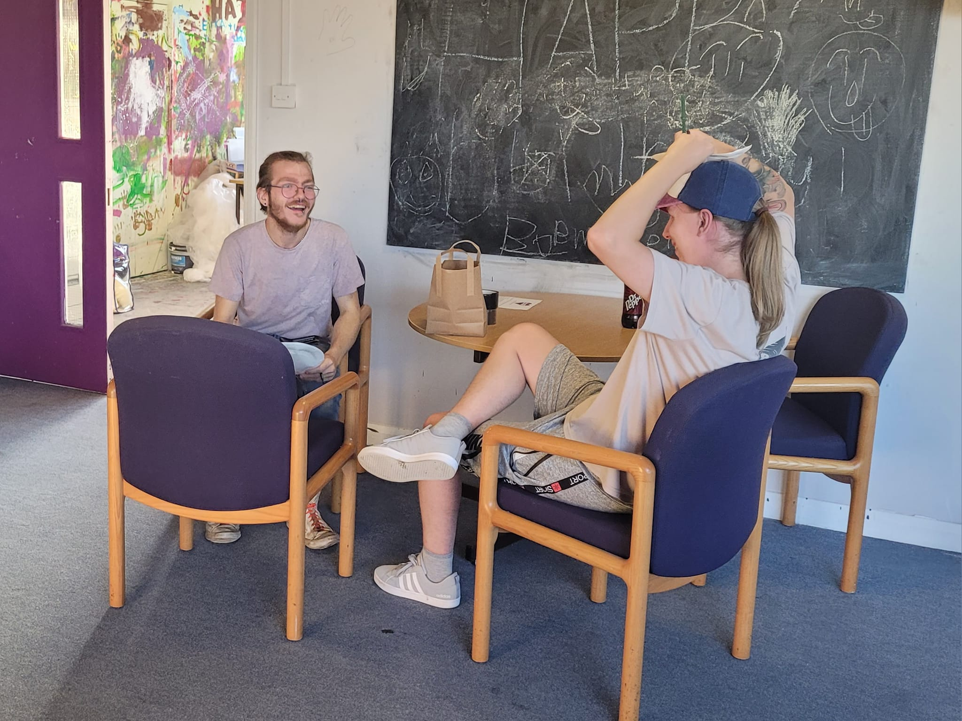
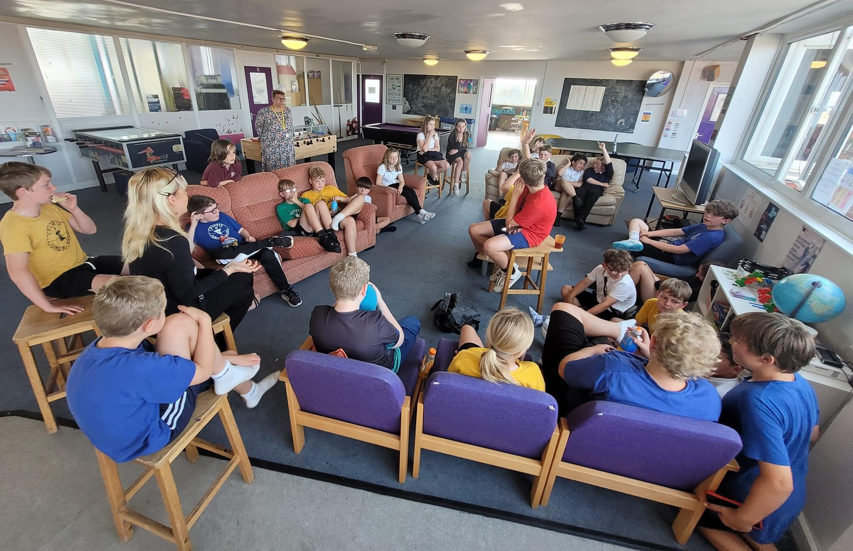
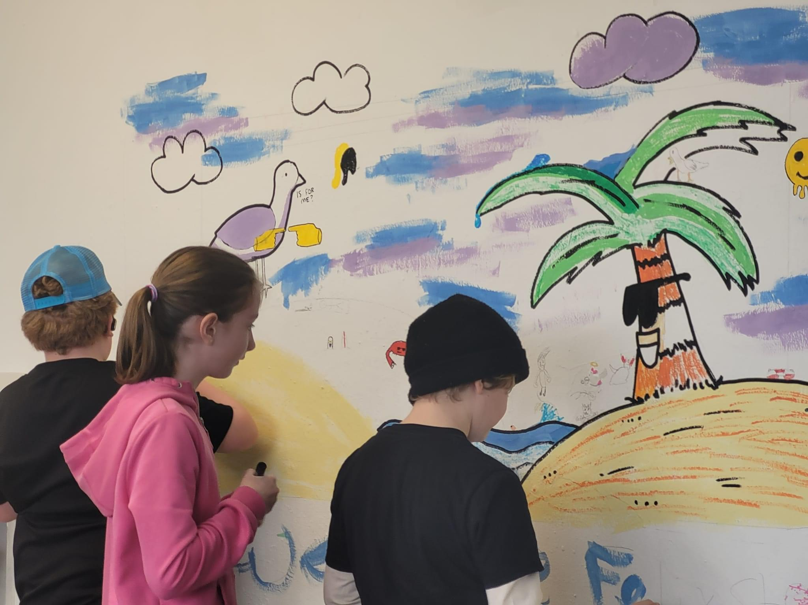
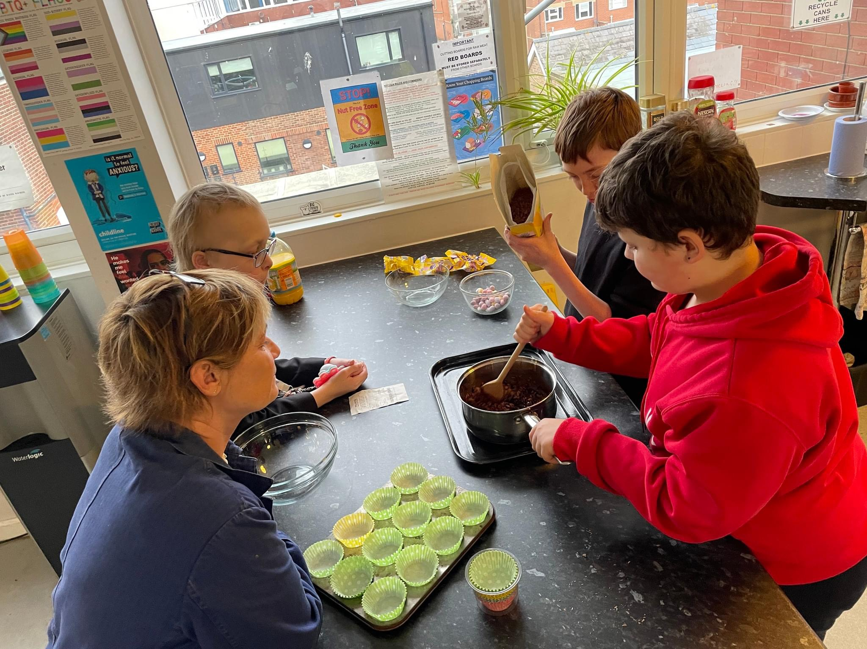
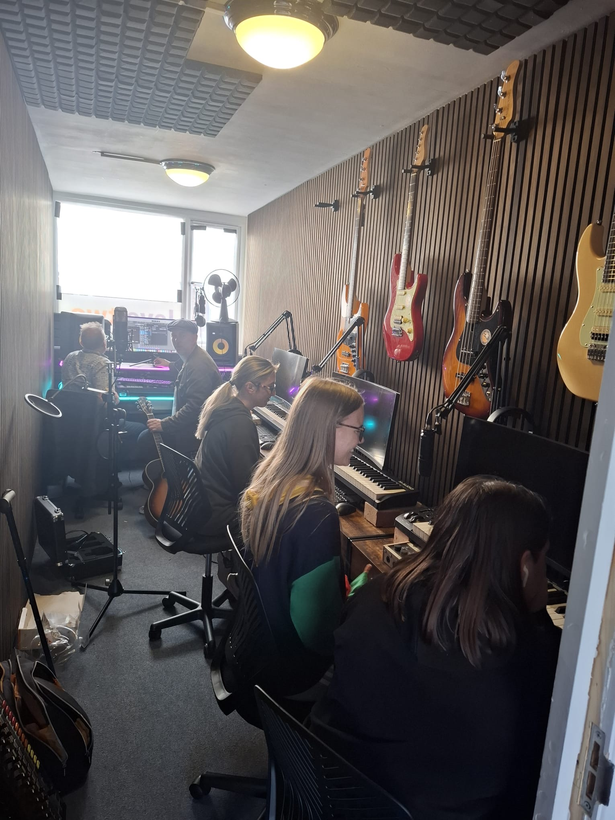
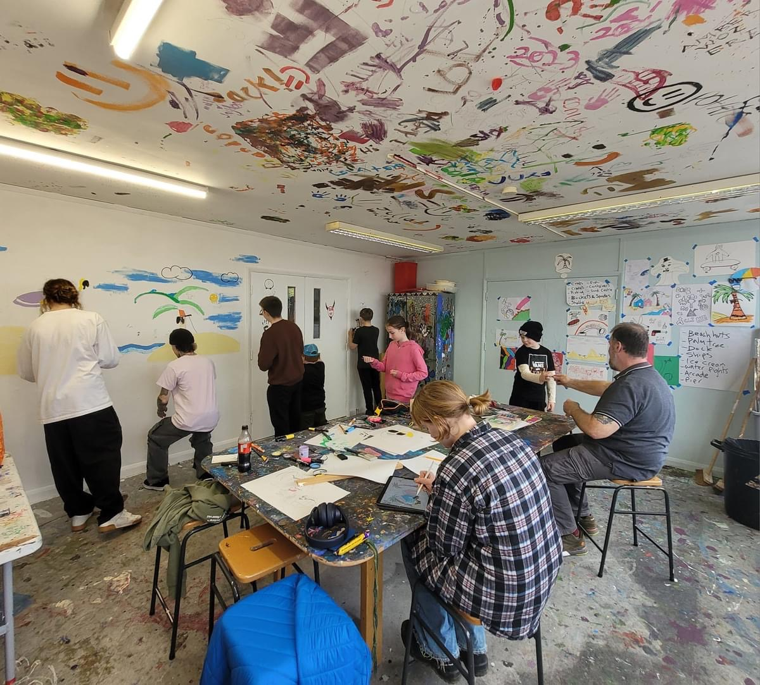
Level Two Youth Sessions
YOUTH SESSIONS @ LEVEL TWO
MONDAY - YEAR 7 - 4:00 - 5:30PM
WEDNESDAY DRAMA SESSION - 10-25 YEARS - 4:00 - 5:30PM
WEDNESDAY YOUNG ADULTS SESSION - YEAR 11+ -25YRS
5:30 - 7:00PM
THURSDAY- YEAR 8, 9, 10 SESSION
4:00- 5.30PM
SATURDAY - OPEN SESSION - YEAR 6+ -25YRS
10:30 - 12:00PM
@ The Hub Cobbold Road

Slide 3
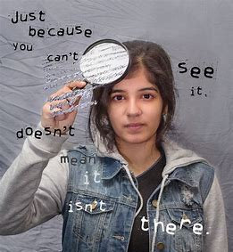


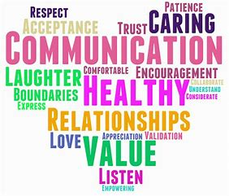
Level Two Mentoring
Referrals can be made via our website www.leveltwo.org

Slide 4
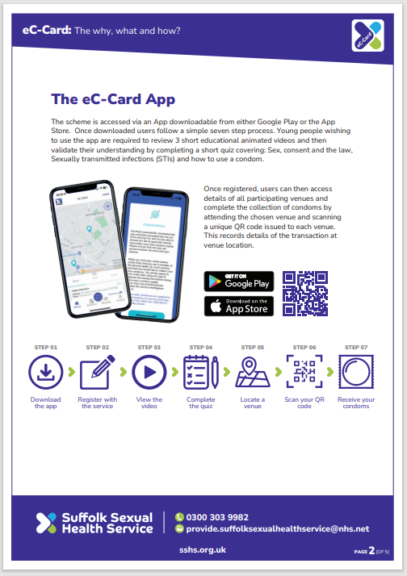

Sexual health support
Download the EC-Card app
Level Two Hub is an approved provider of sexual health products
Confidential support and advice

Slide 5
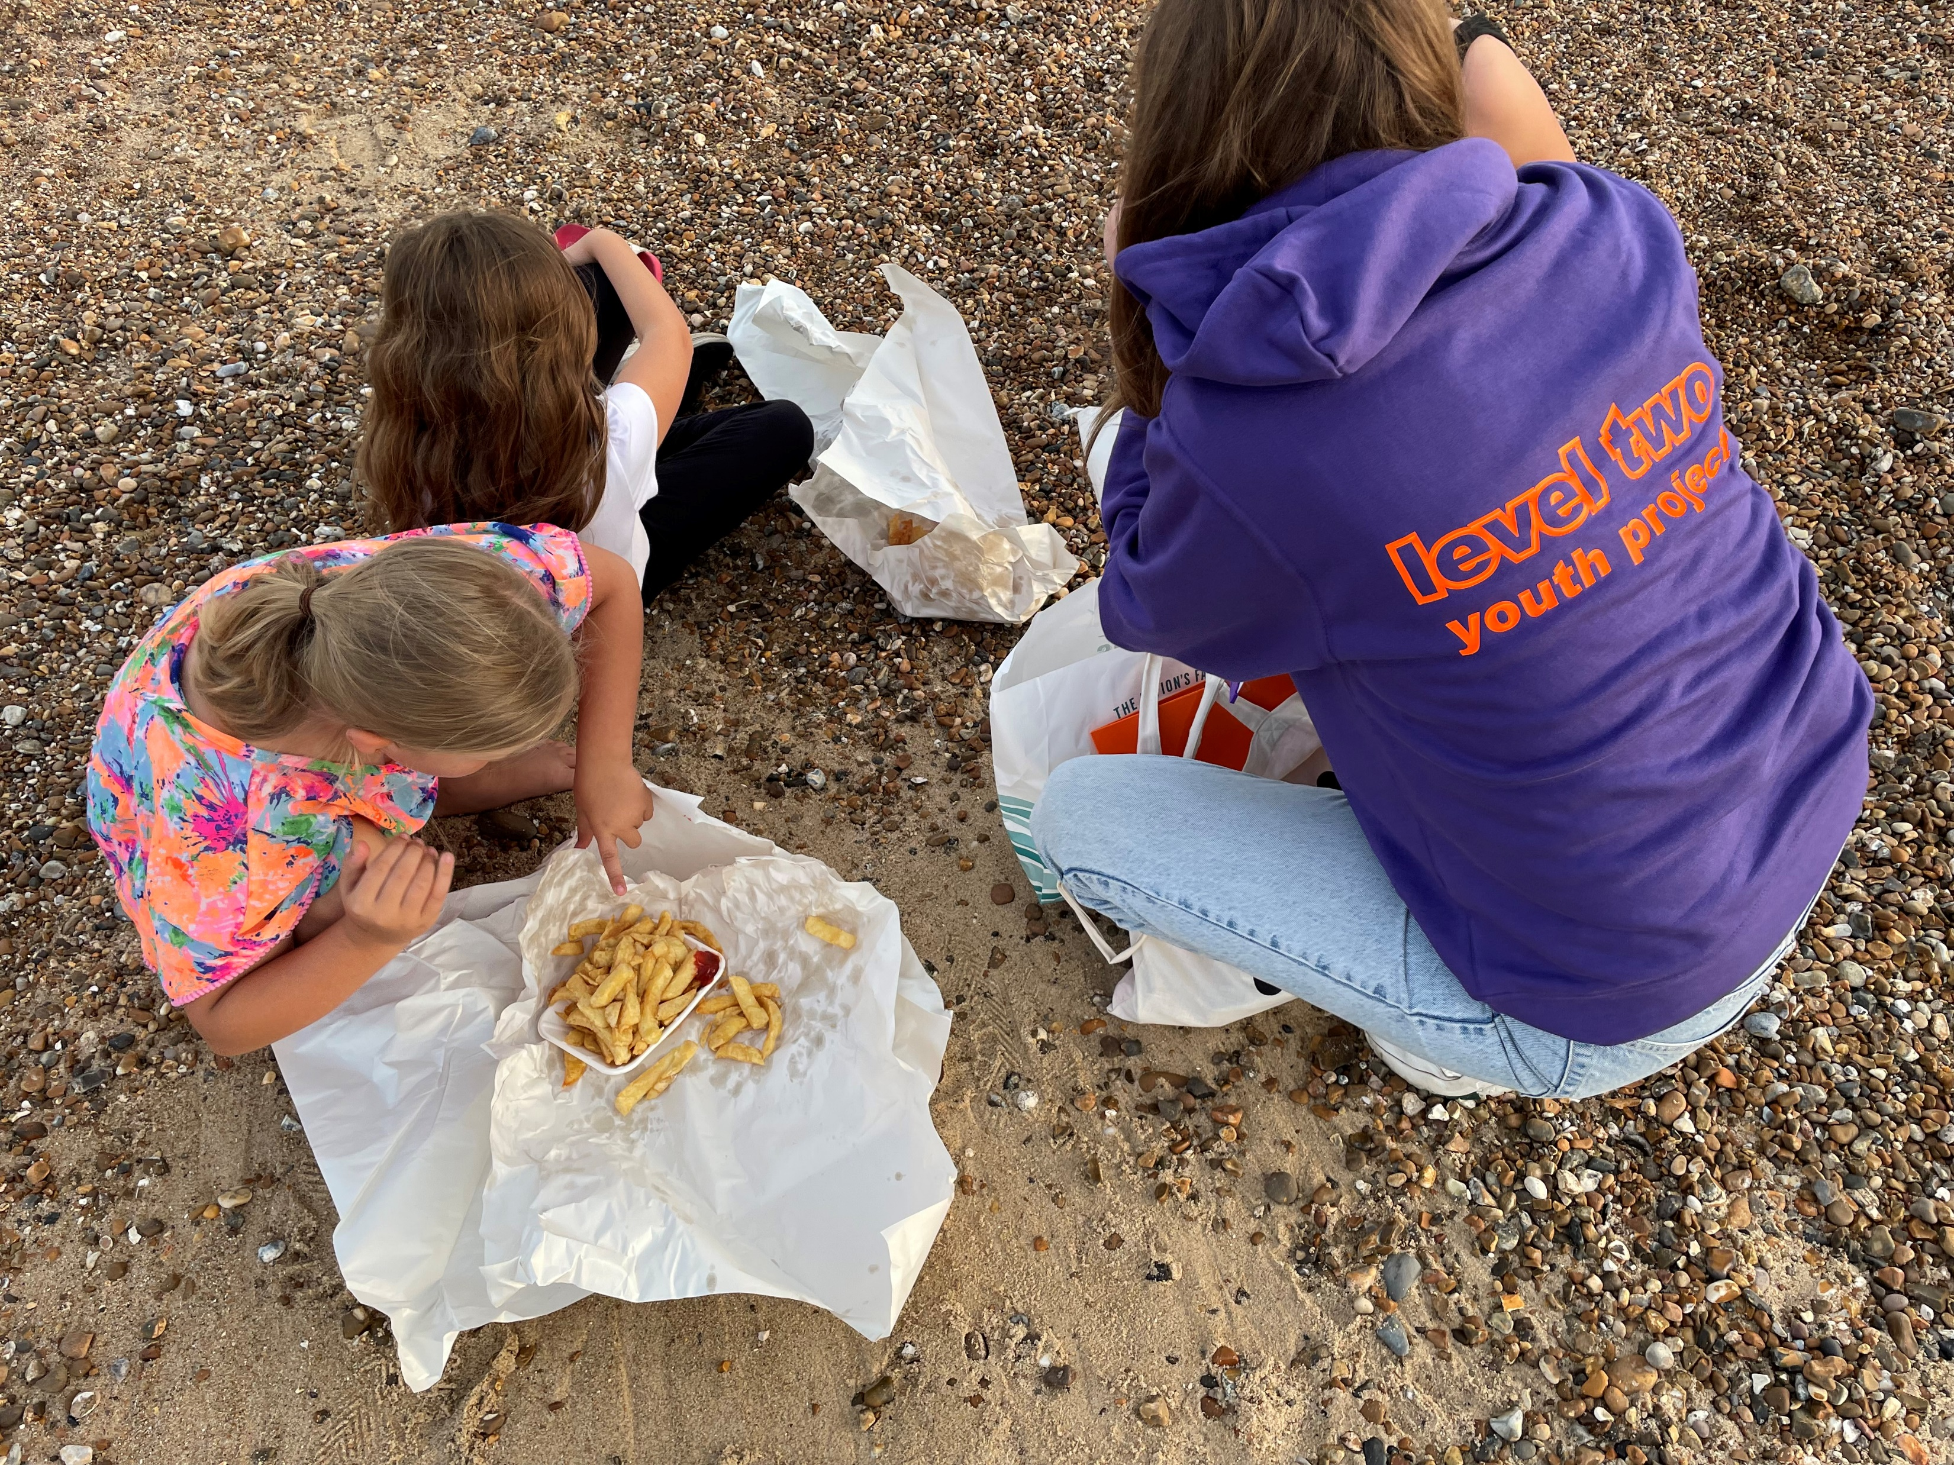
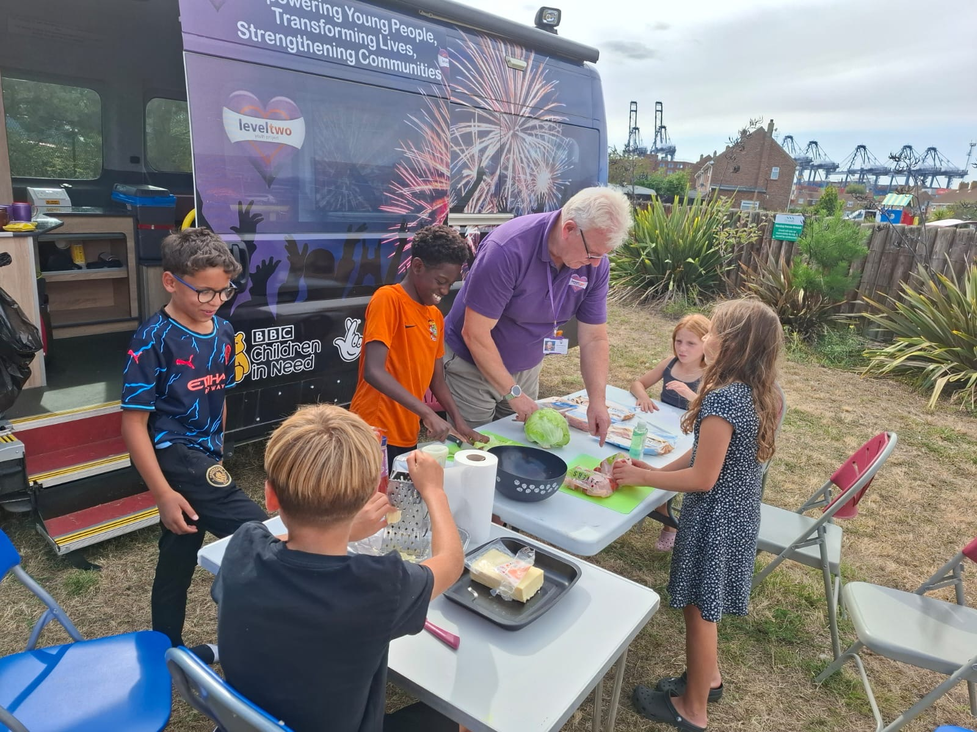
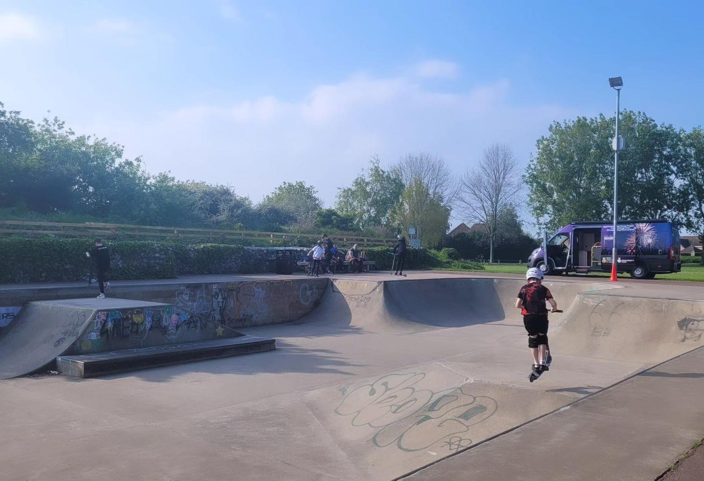
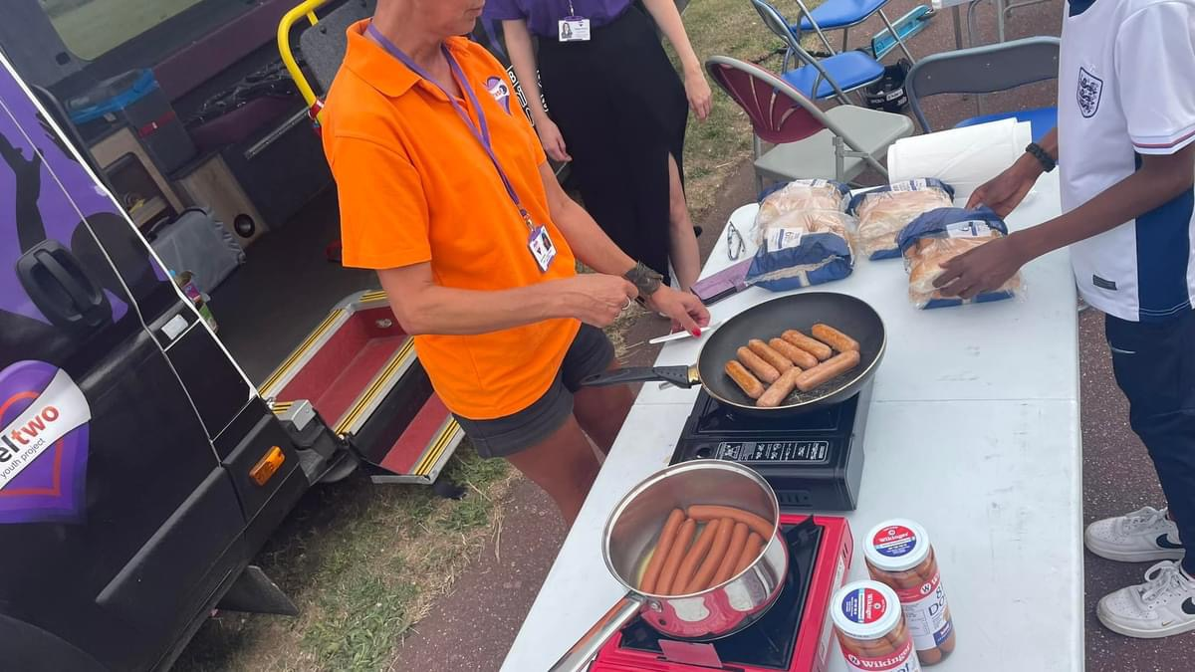
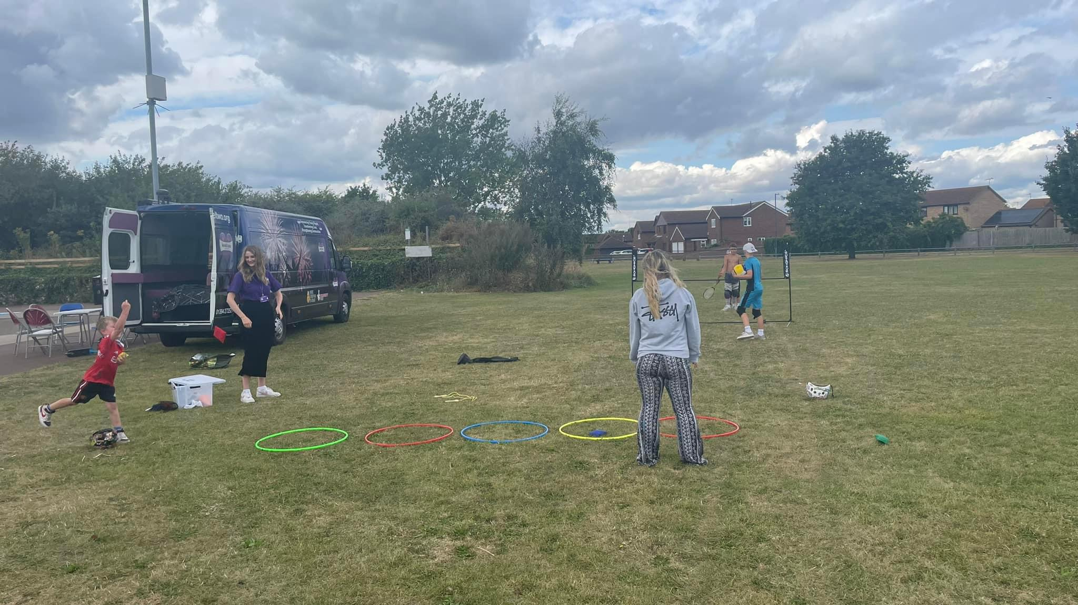
Level Two Detached Sessions
Reaching out in the community

Slide 6

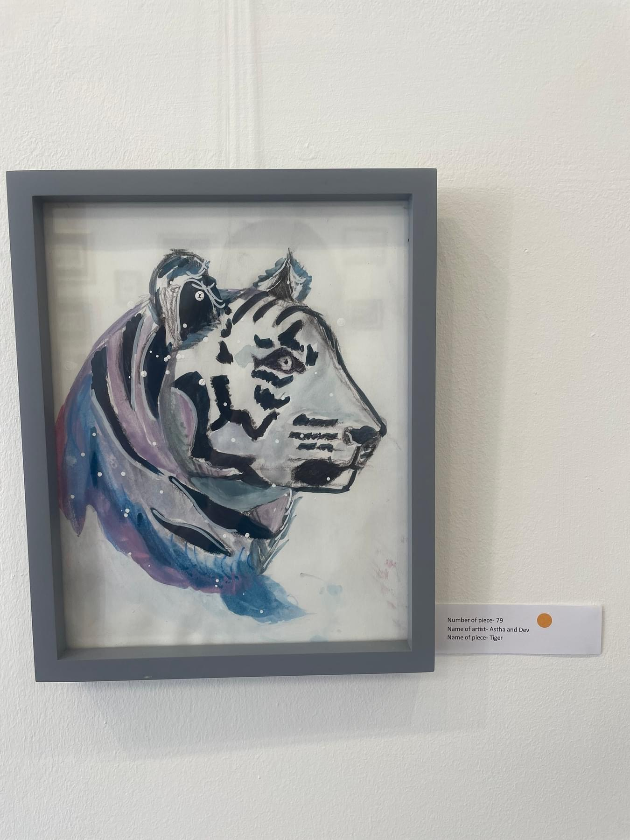
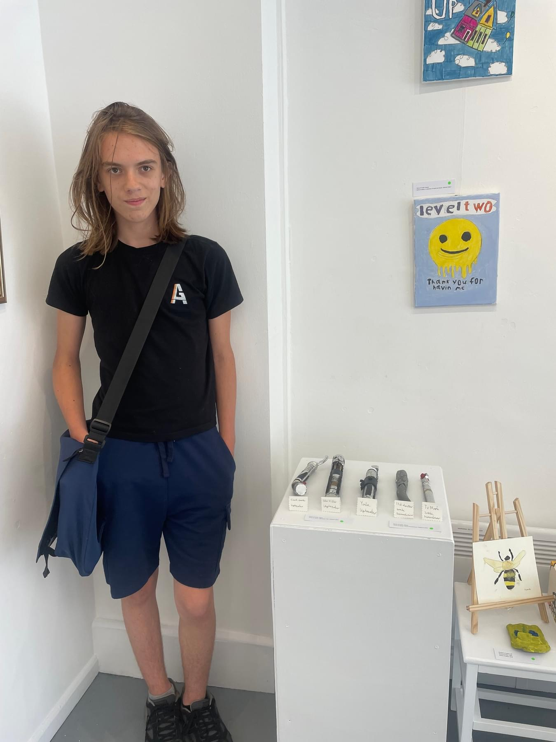
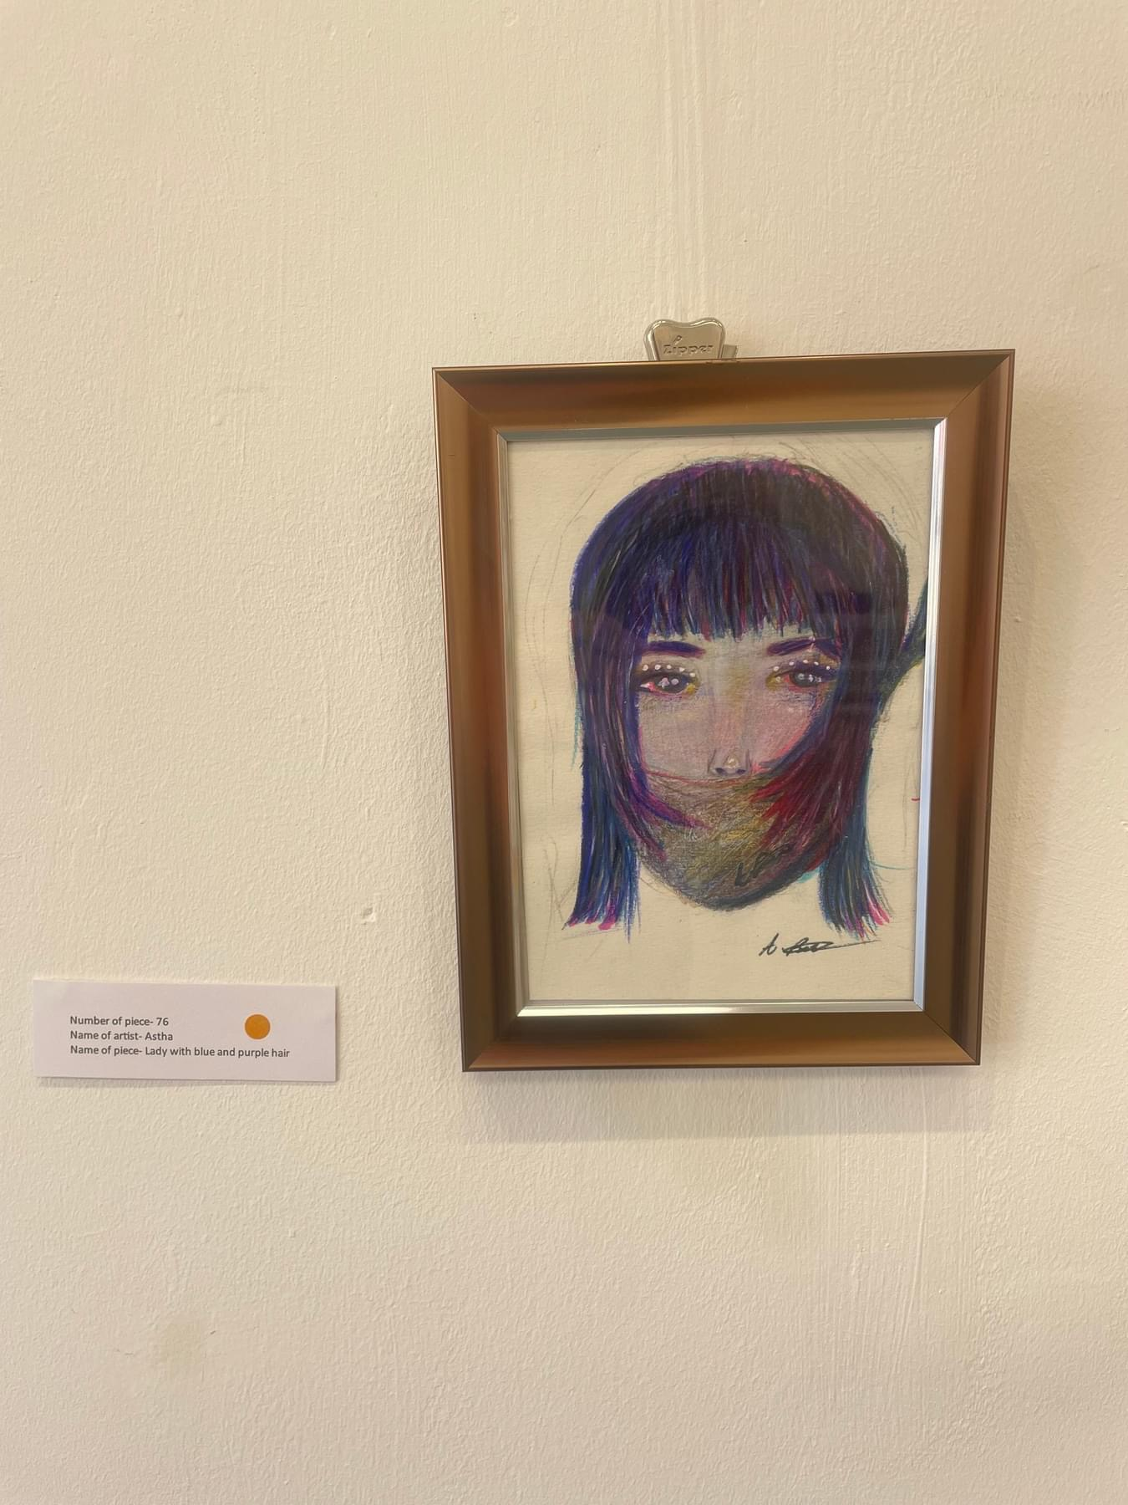

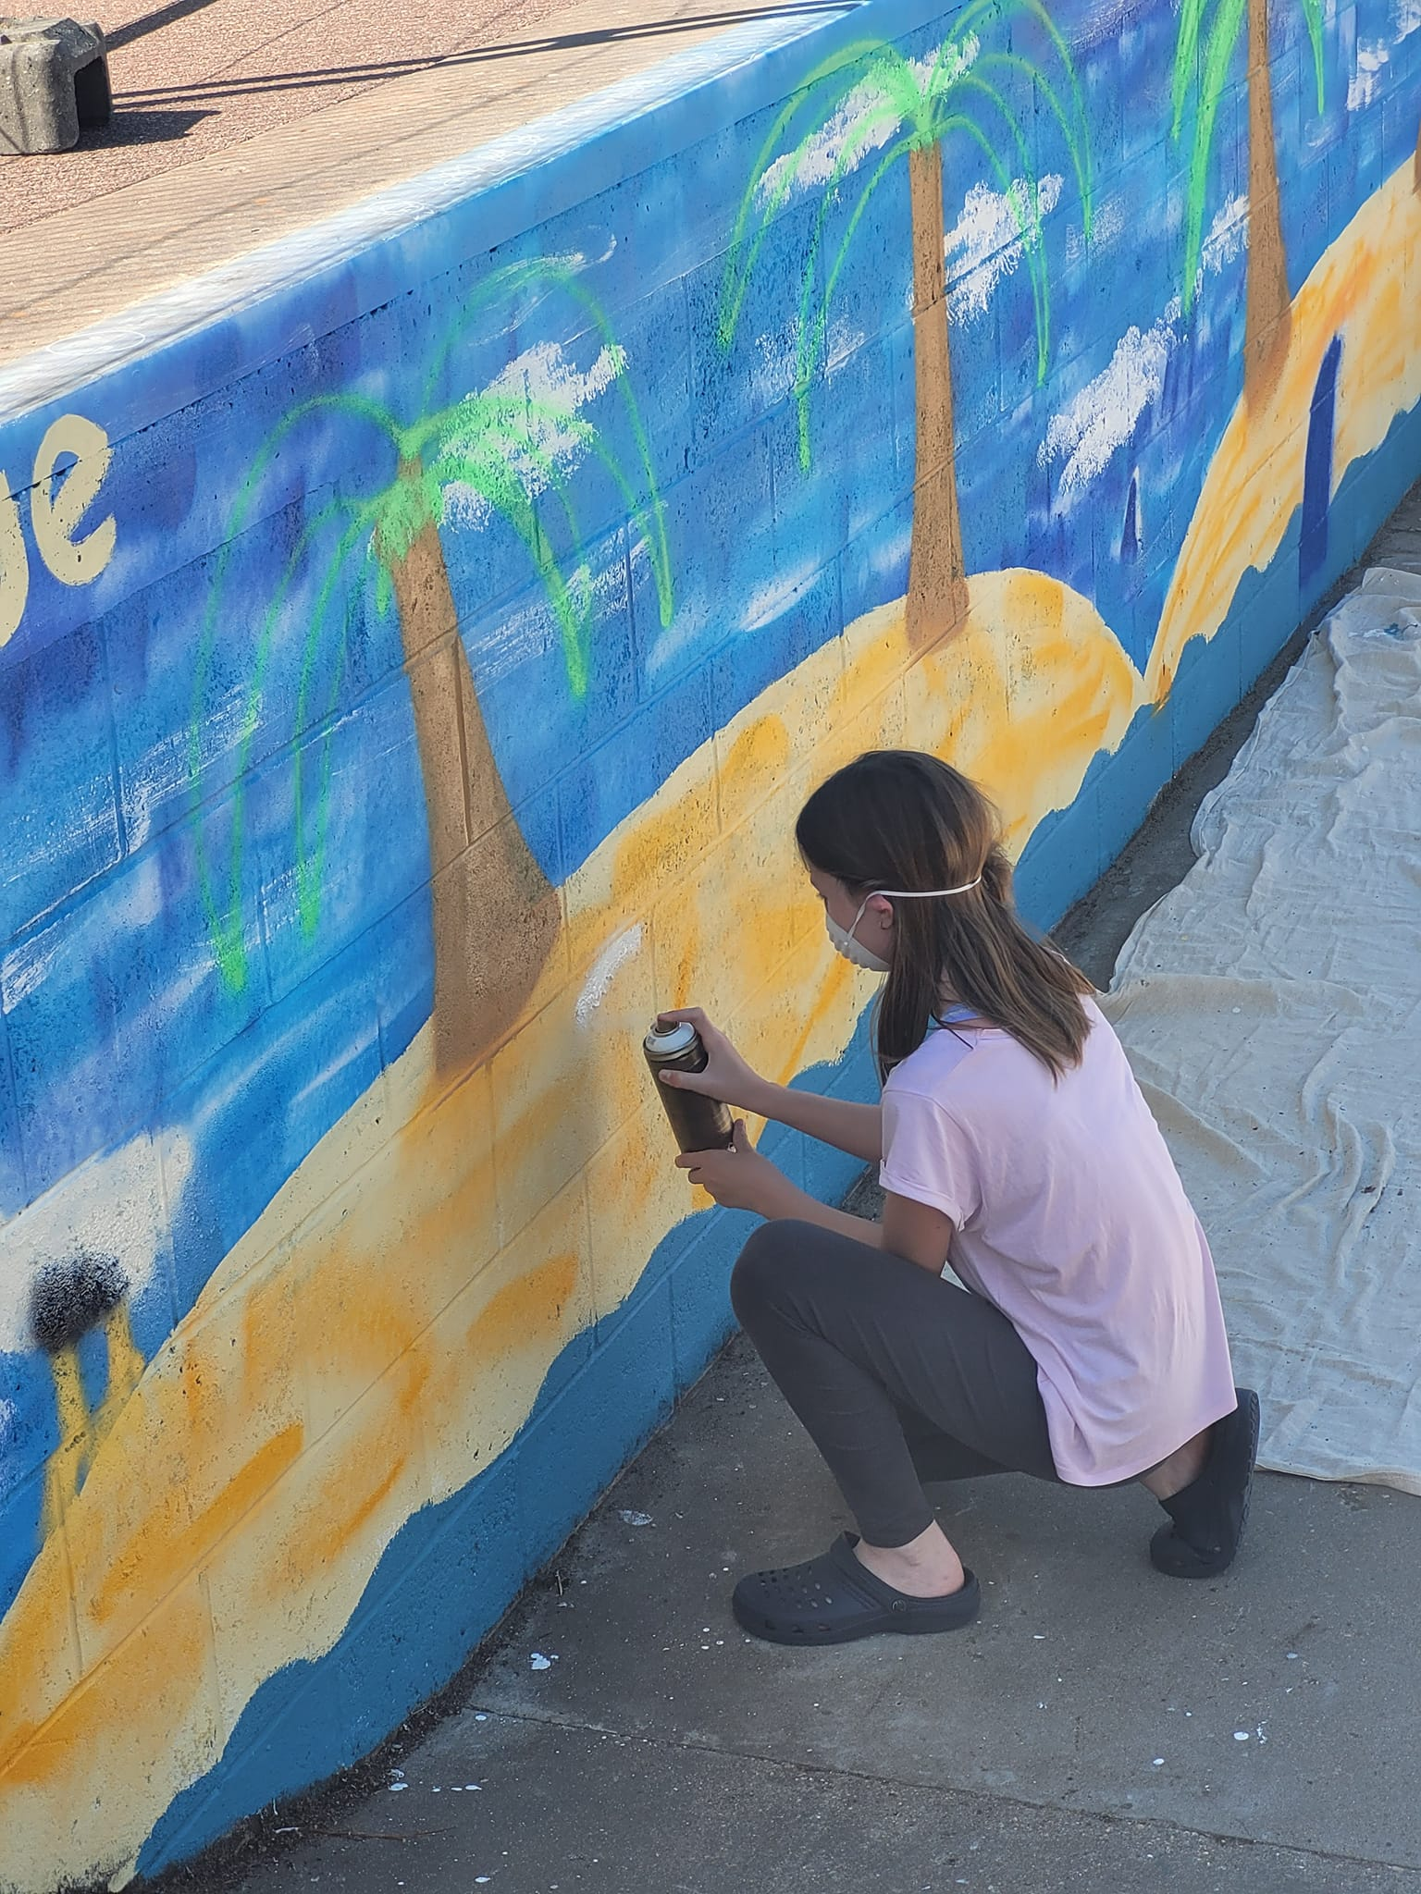
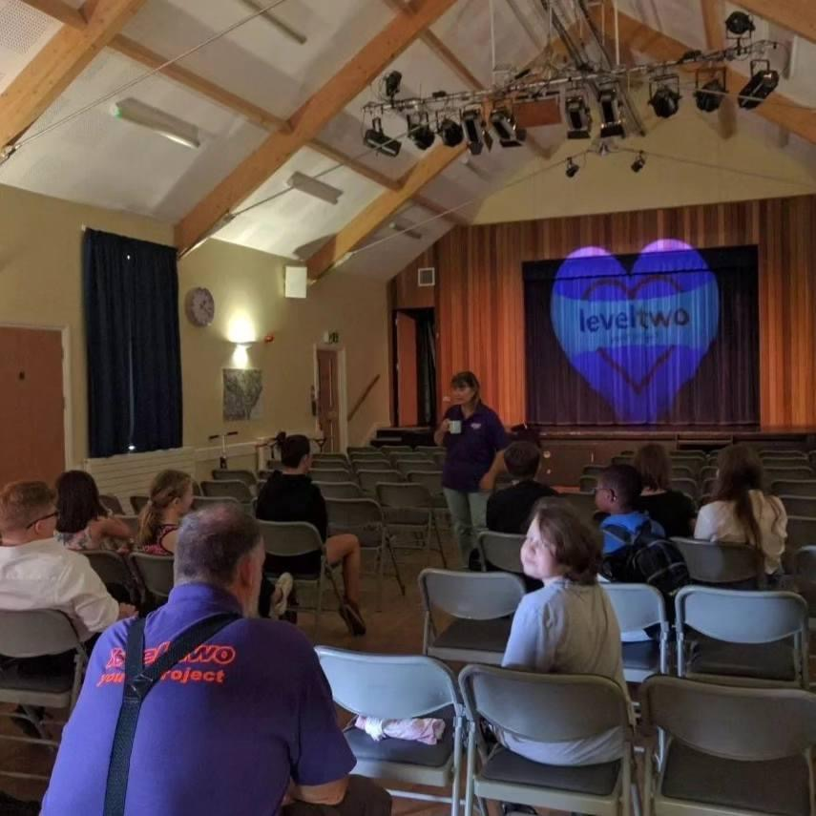
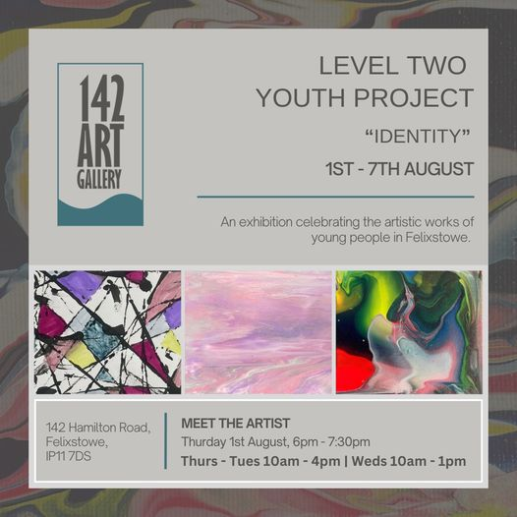
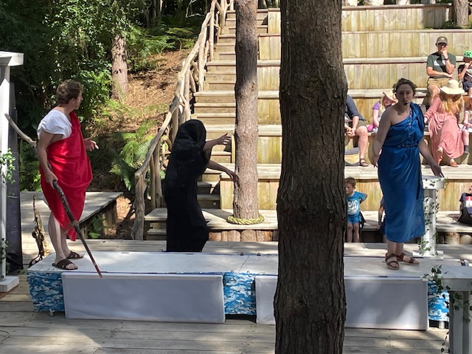
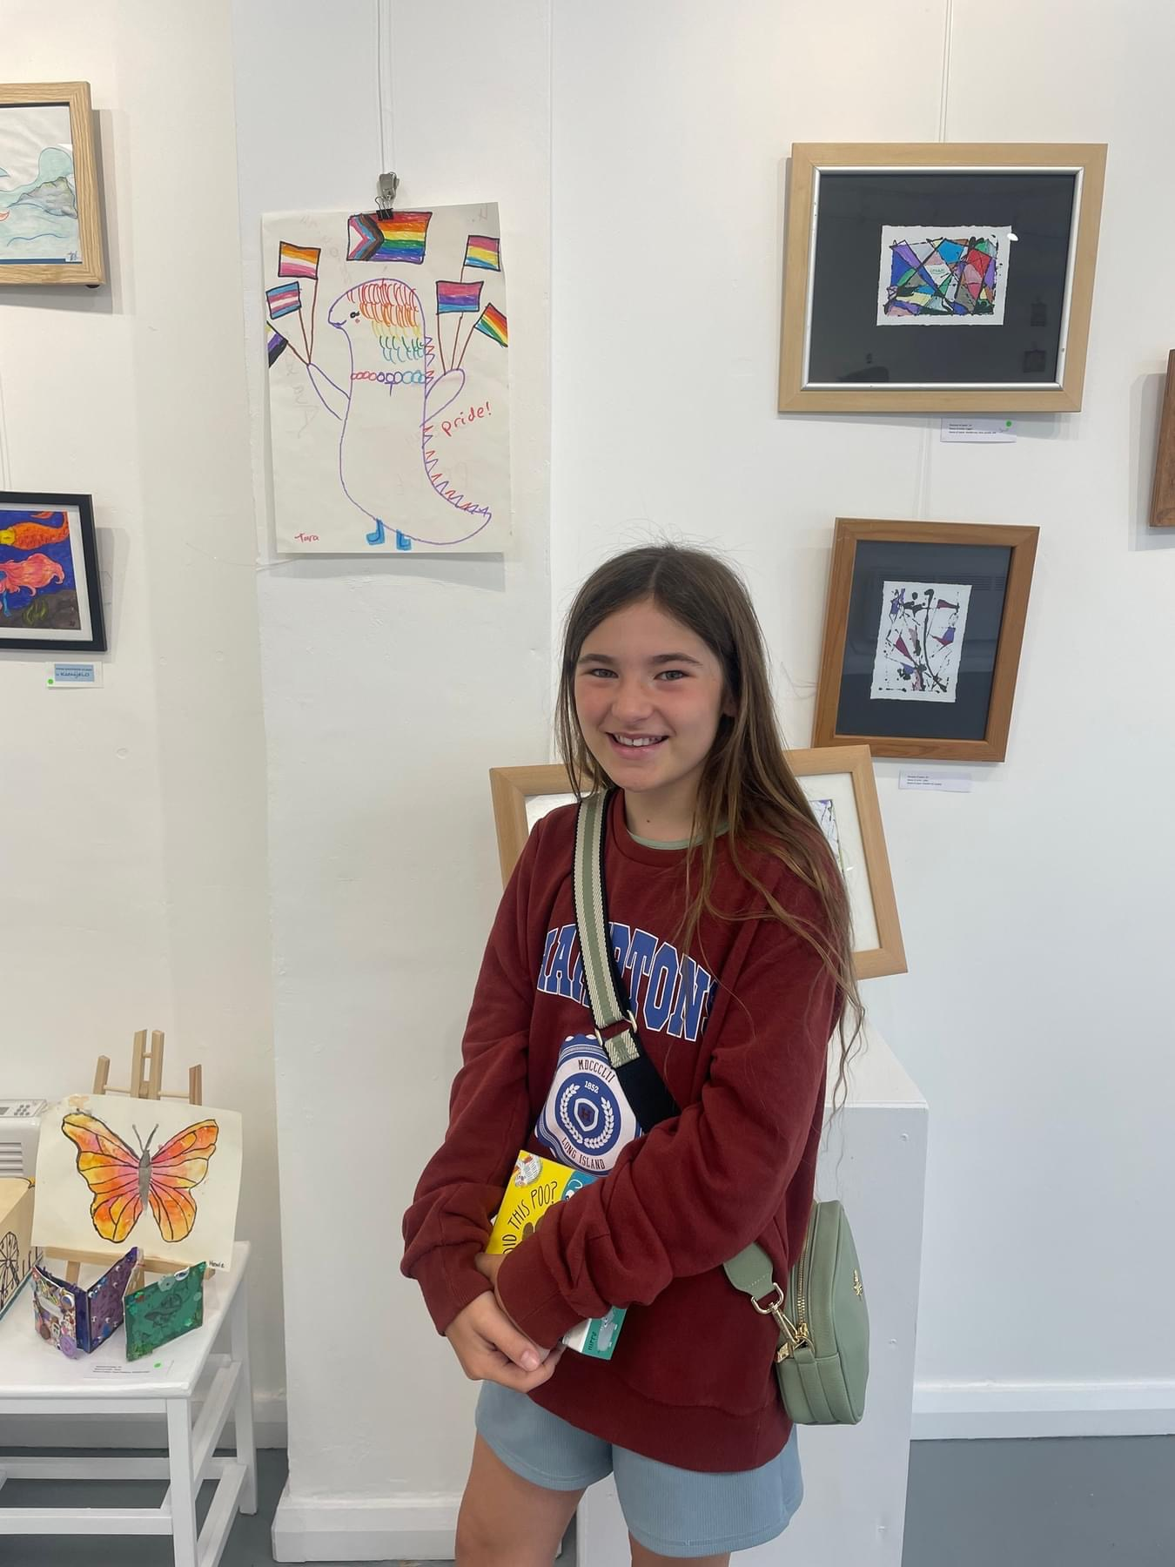
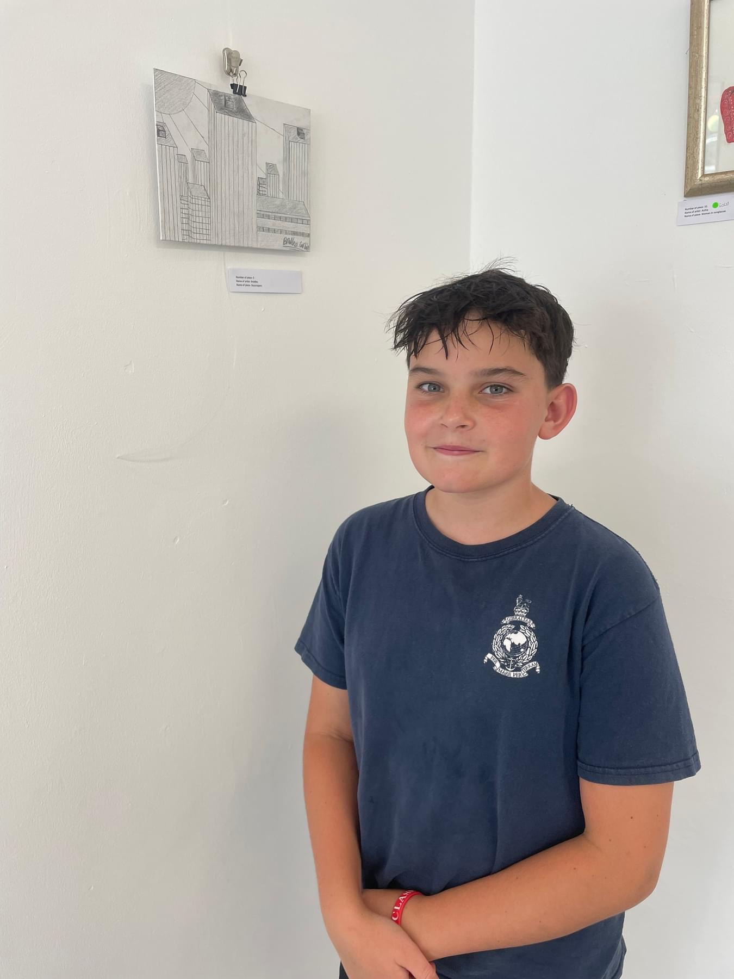

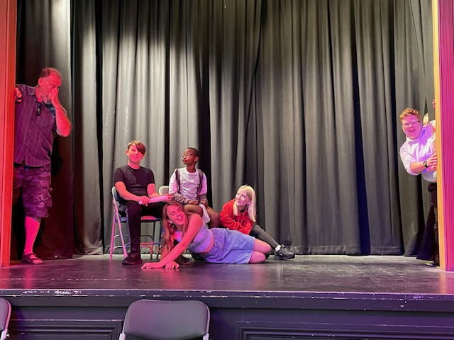
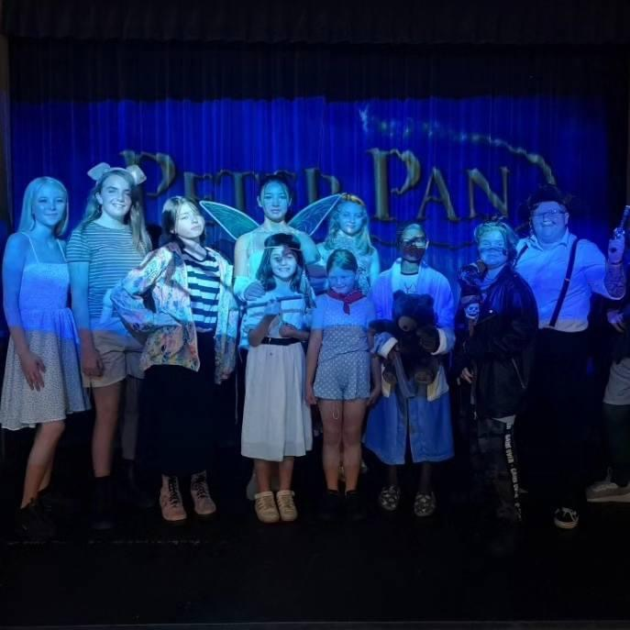
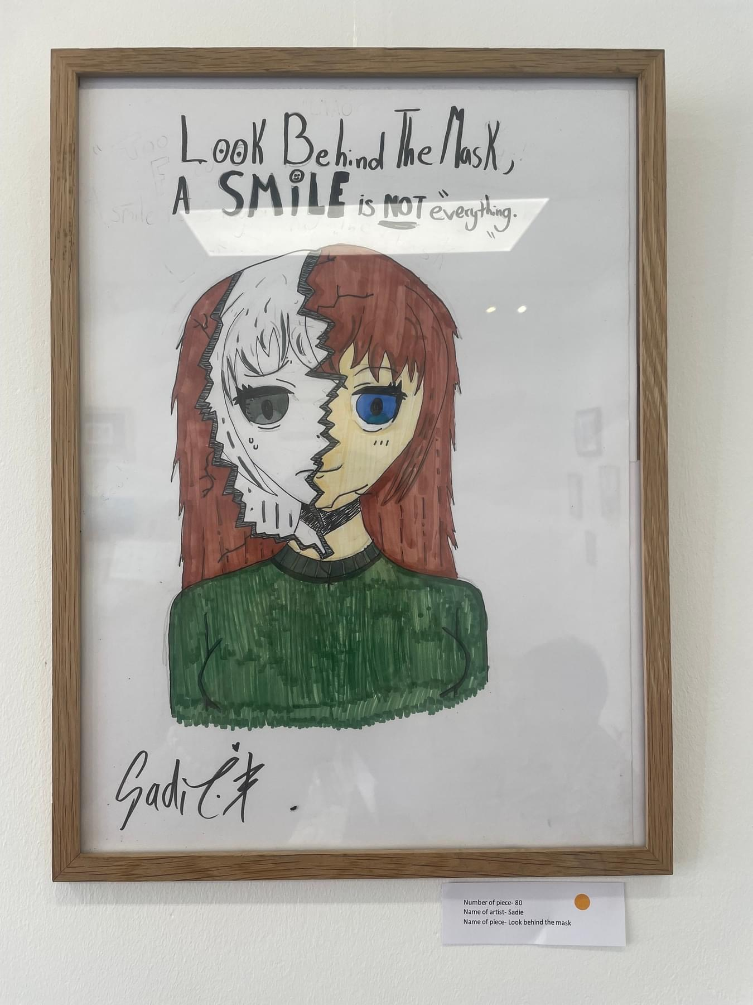
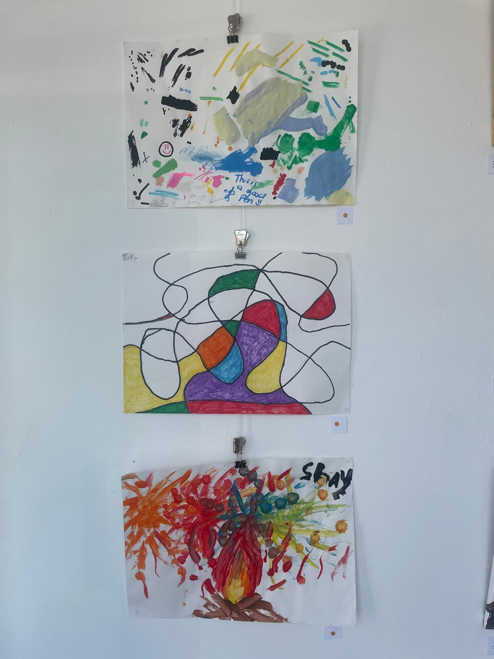
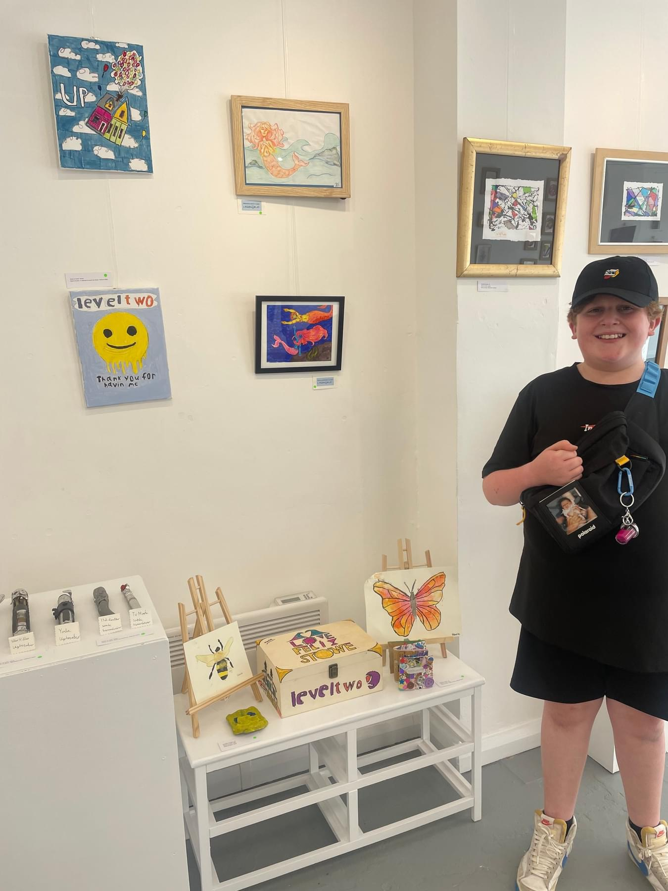
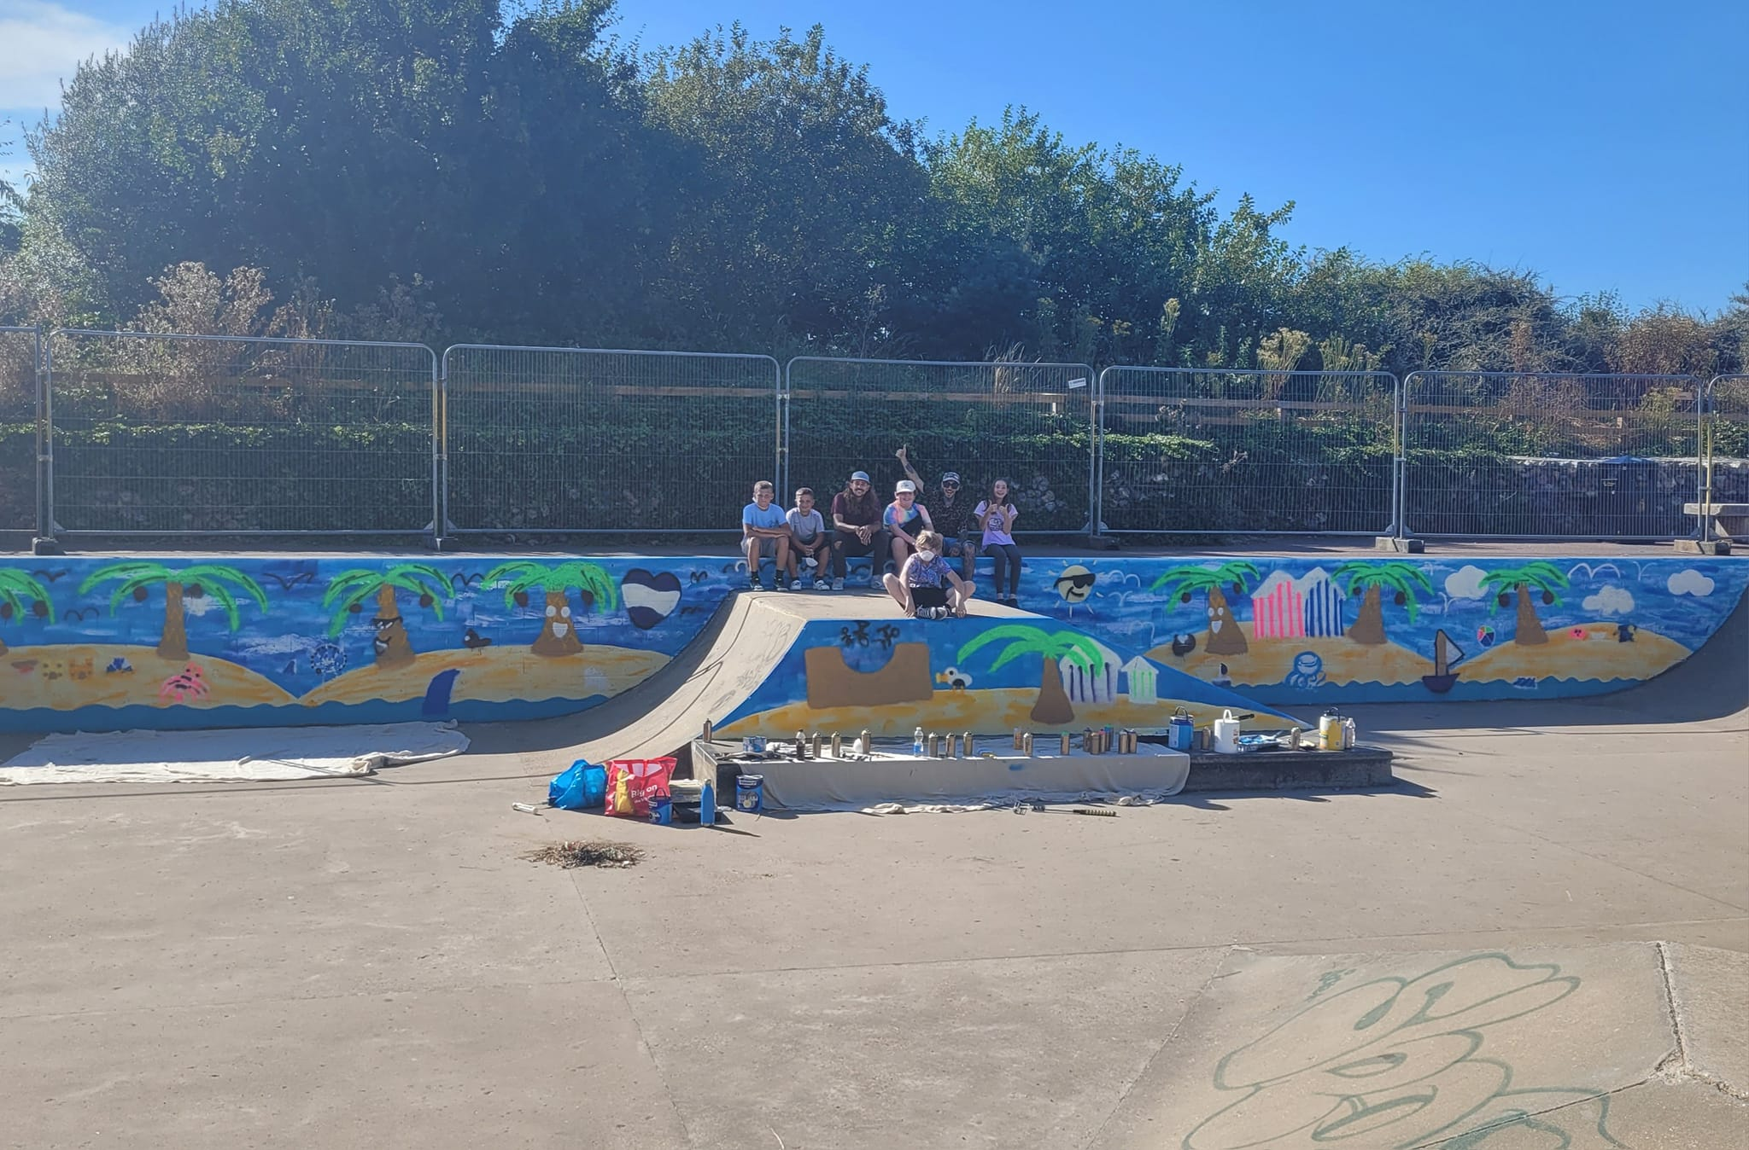
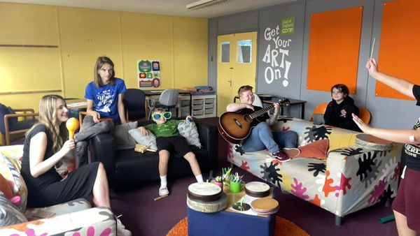
Level Two And The Arts
Inspiring creativity and
self-exploration in all that we do

Slide 7
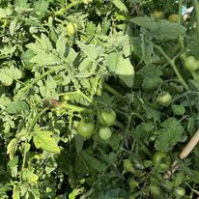
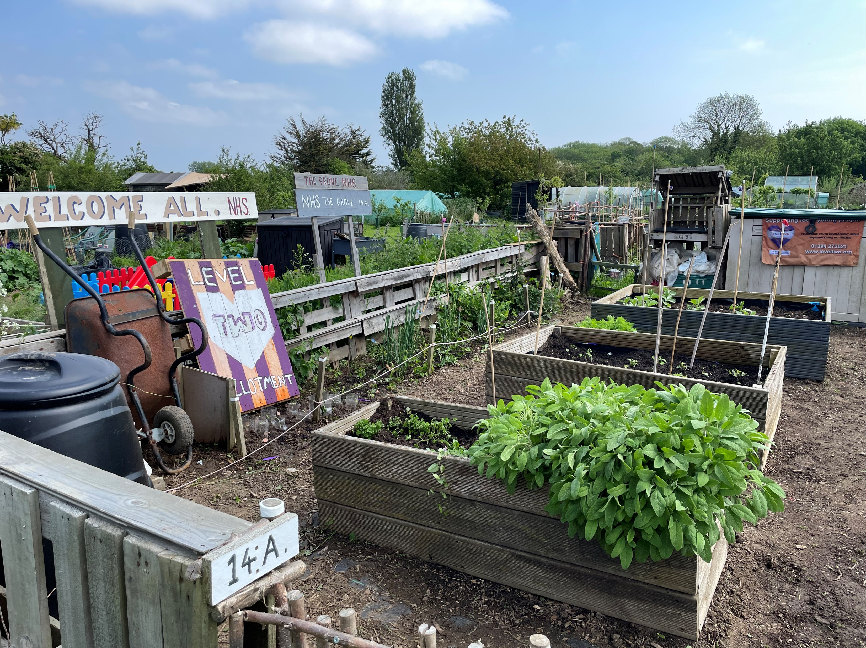
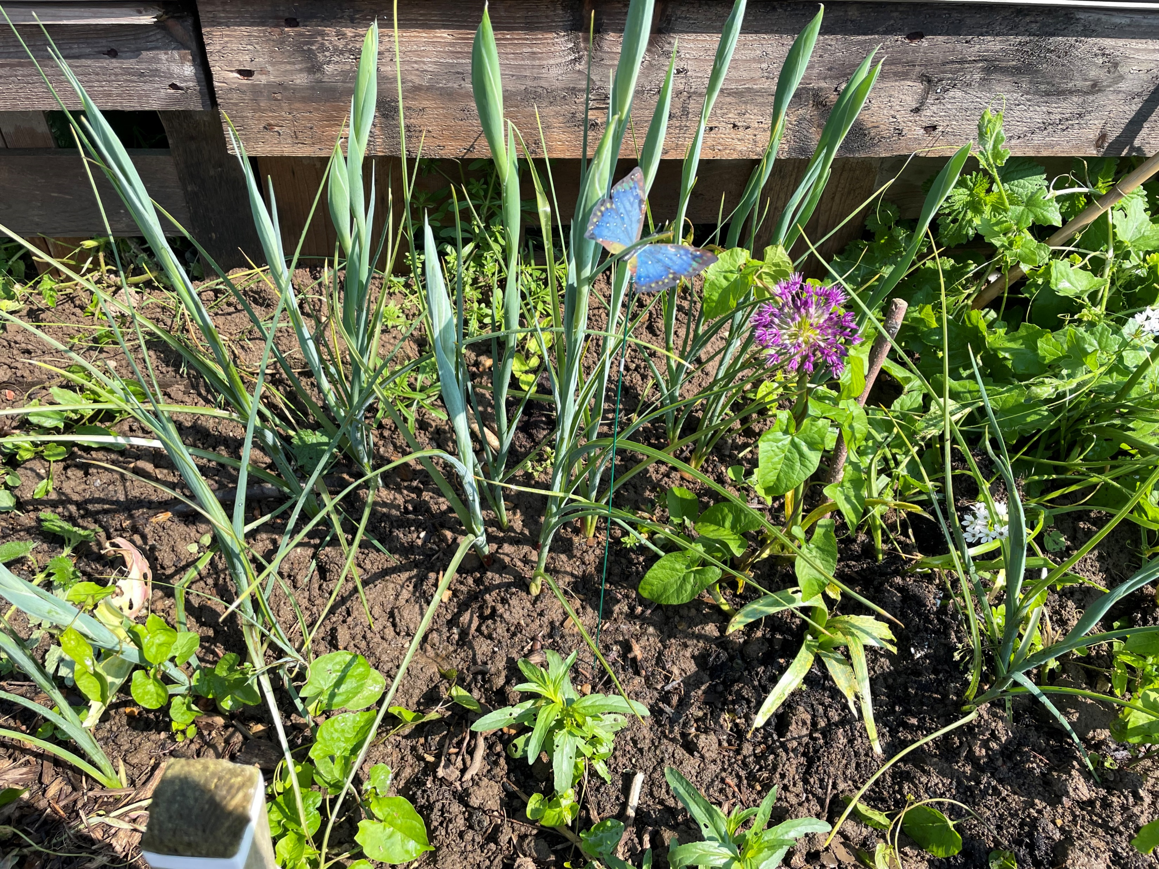
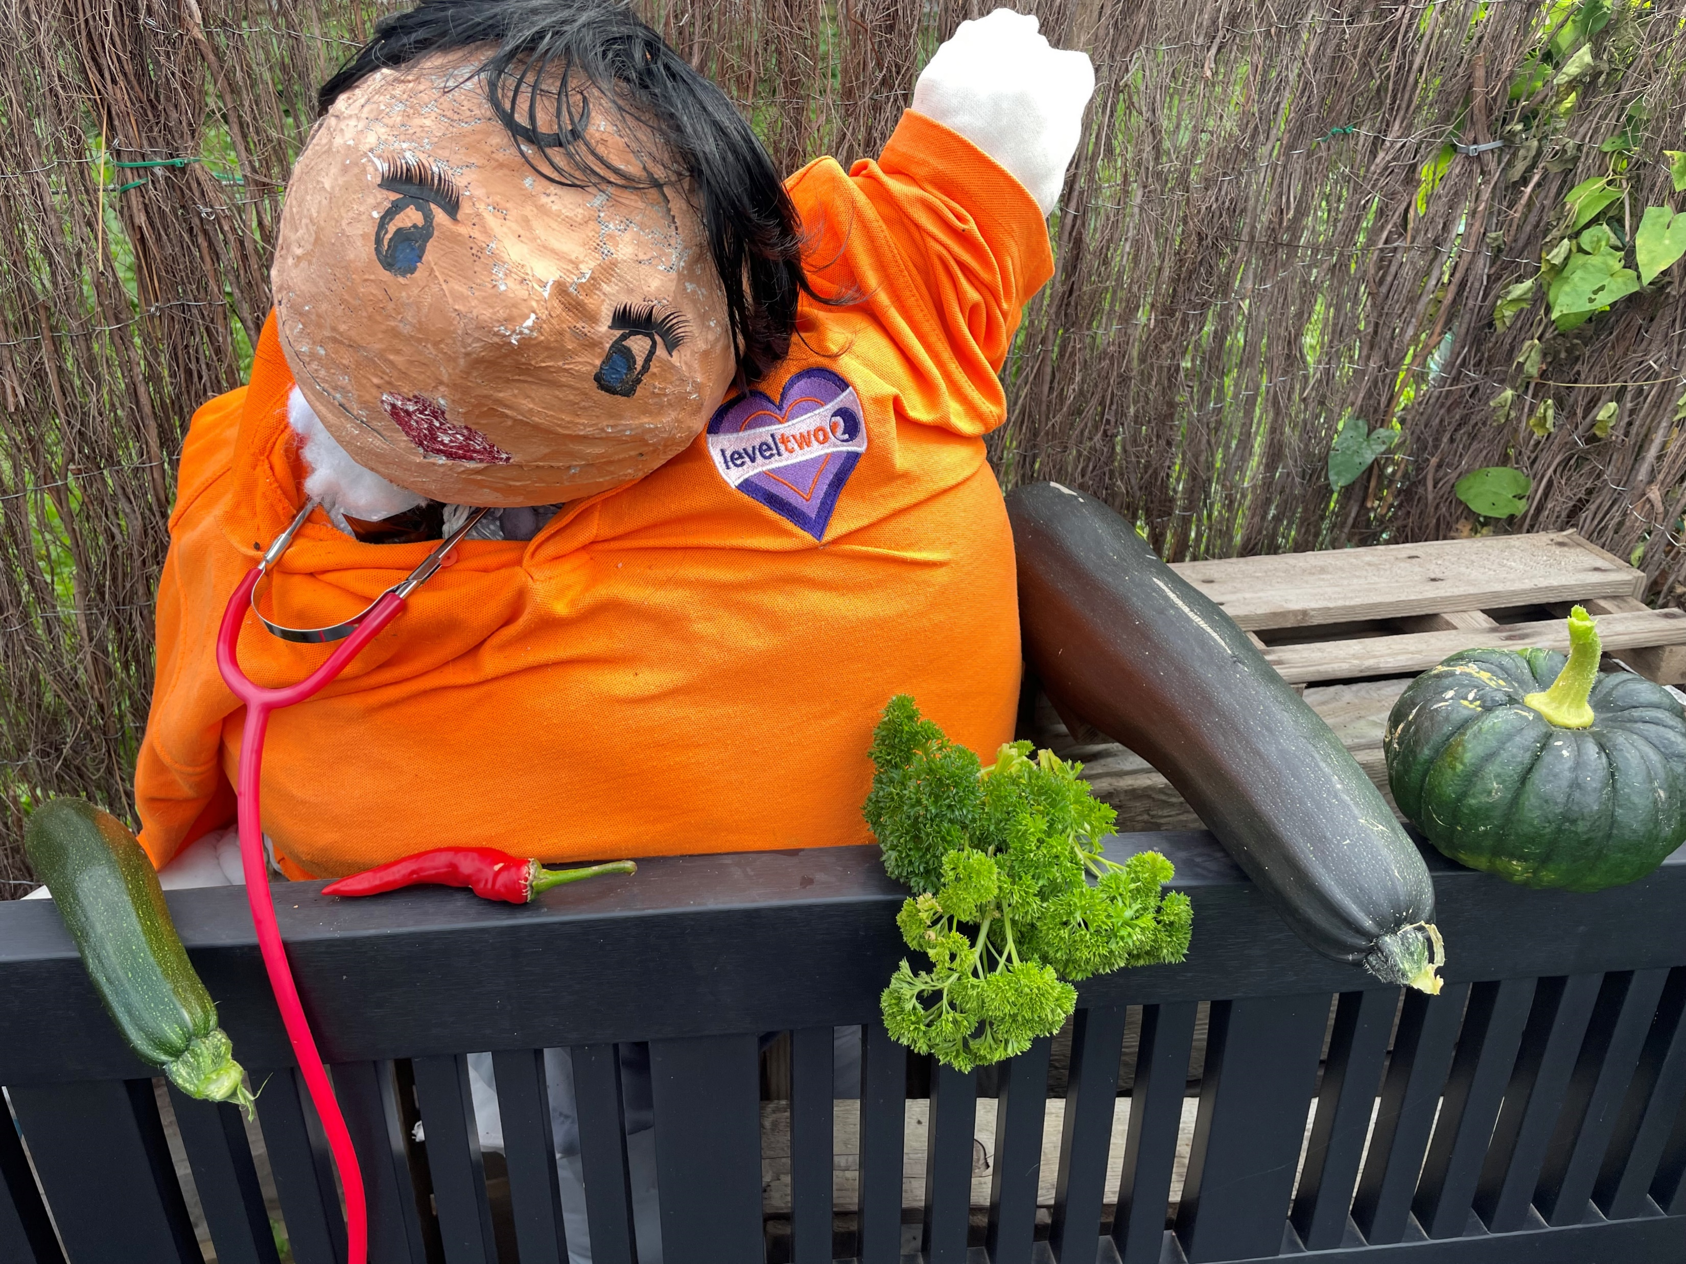
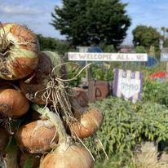
Level Two Sustainability
Supporting our community and environment to thrive

Slide 8
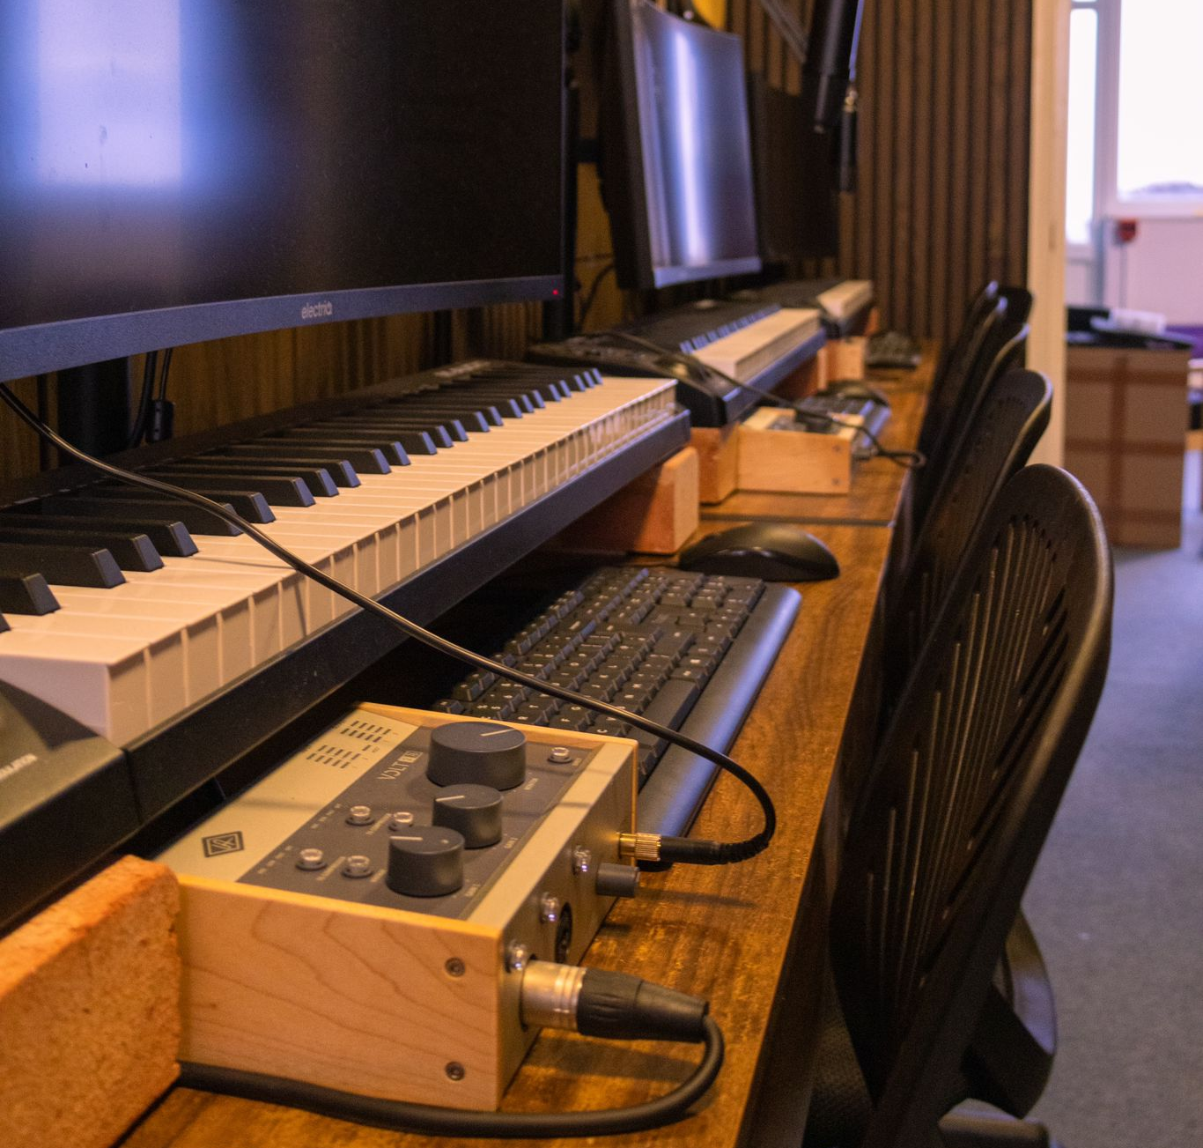
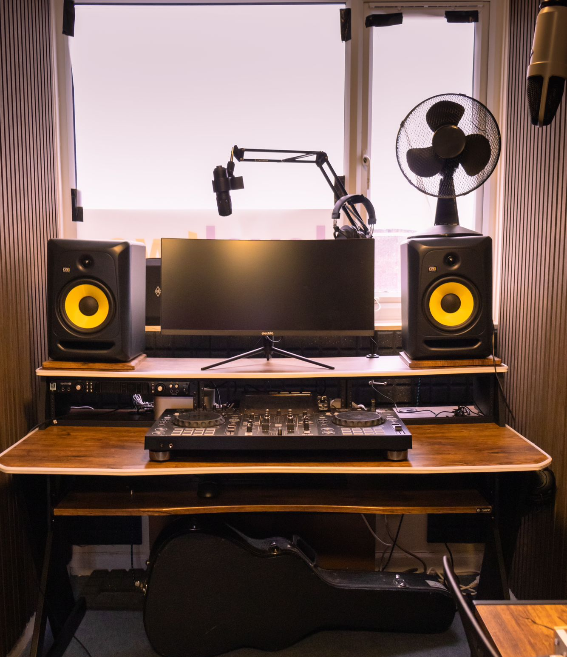
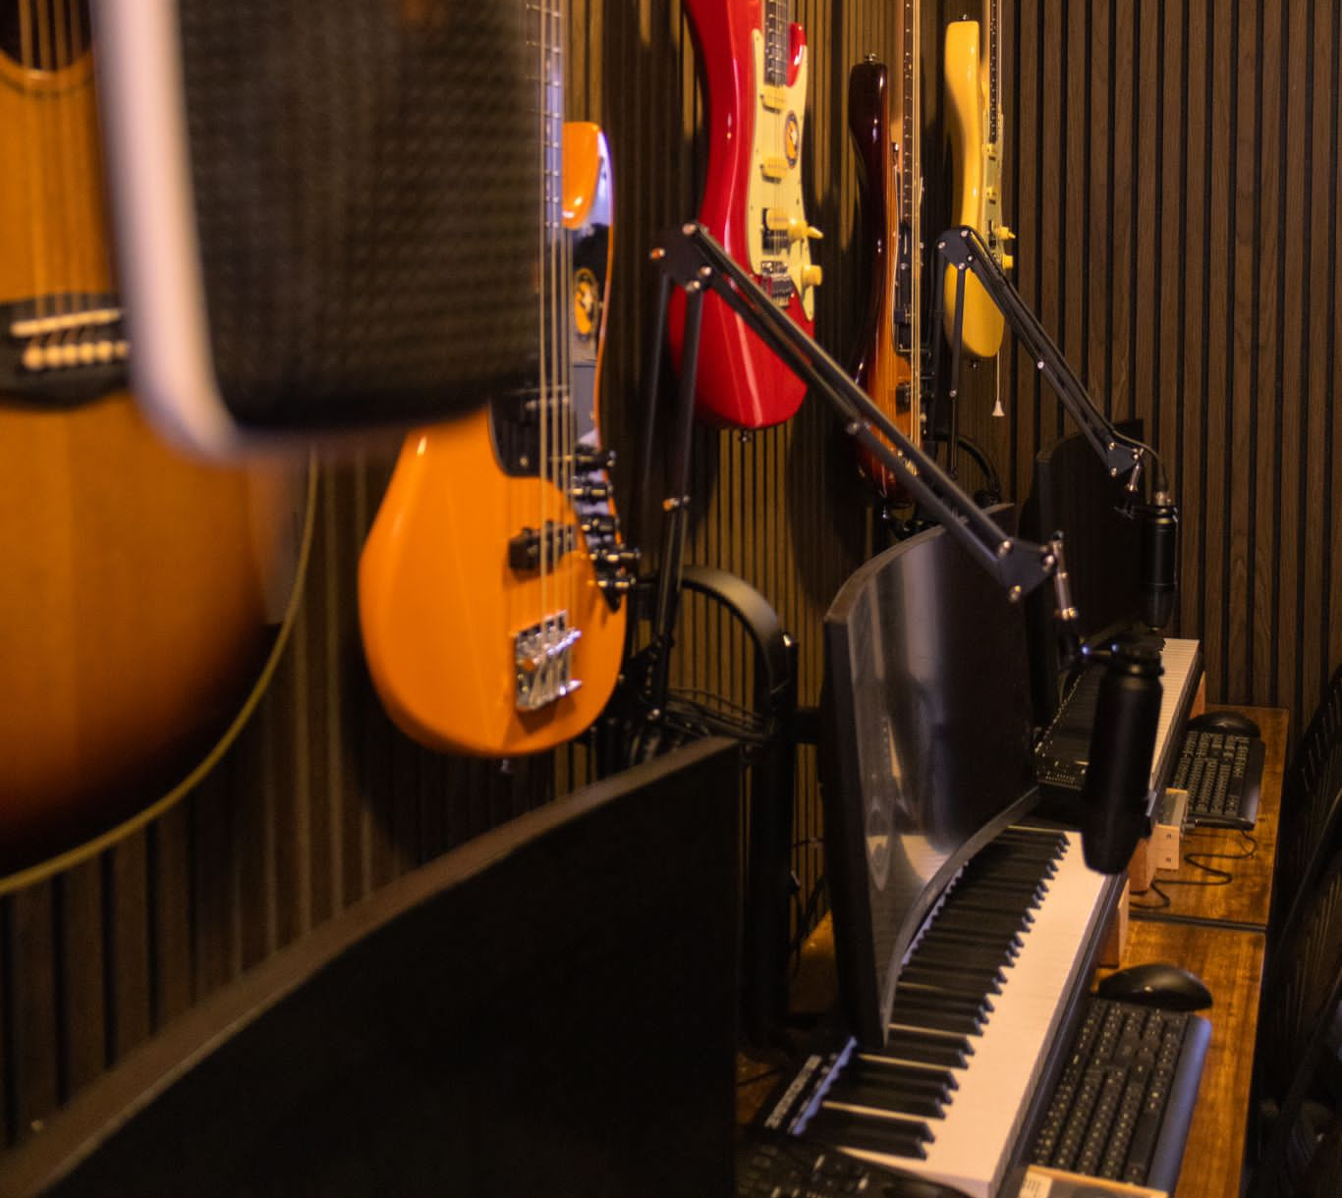
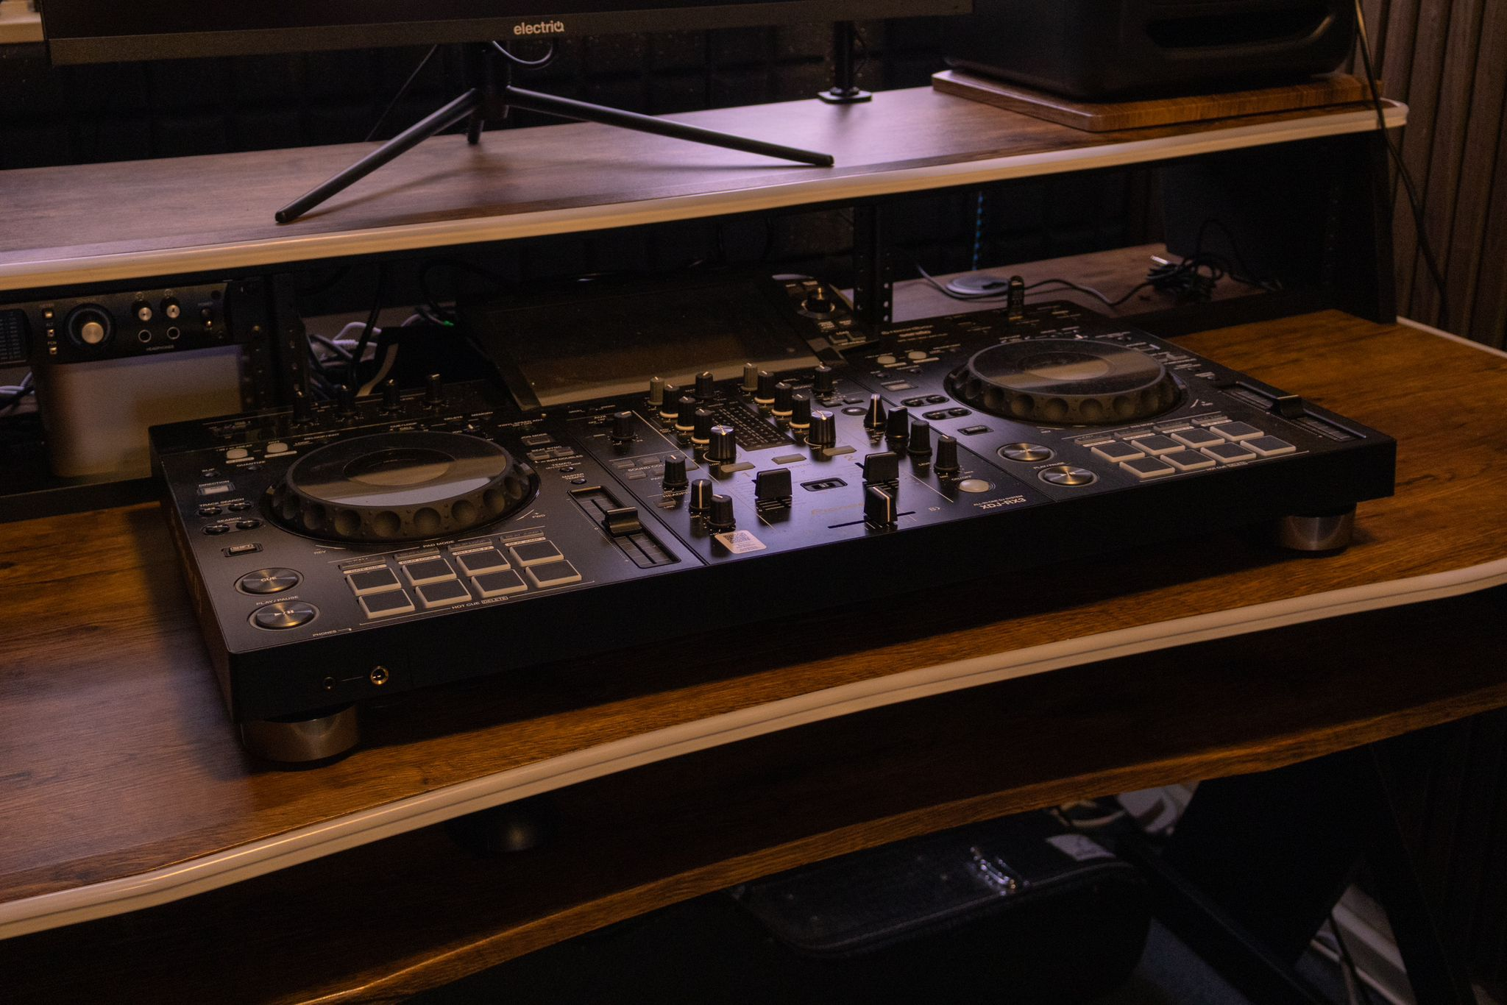
Level Two
Music and Multimedia Studio

Slide 9
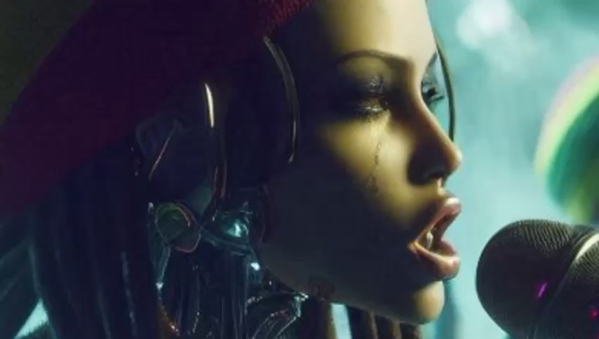
Level Two
Music Production workshop
Second week of Half Term
5 – 8th October.
Complete the course to gain free access to the music studio

Slide 10


www.leveltwo.org
Level Two services are available to young people aged 7-25.
We're here to listen and support you when you need it.
We provide spaces to relax, meet new people, and explore your
creativity, whether that’s in the art room, the music studio, in Arts Award or out in the community.
We understand that youth sessions aren’t for everyone, and that’s okay.
Let us know what services and activities you’d like to see, and we’ll do our best to make them happen.
Thanks for listening.
Contact us: fydg@leveltwo.org

